Slide 1



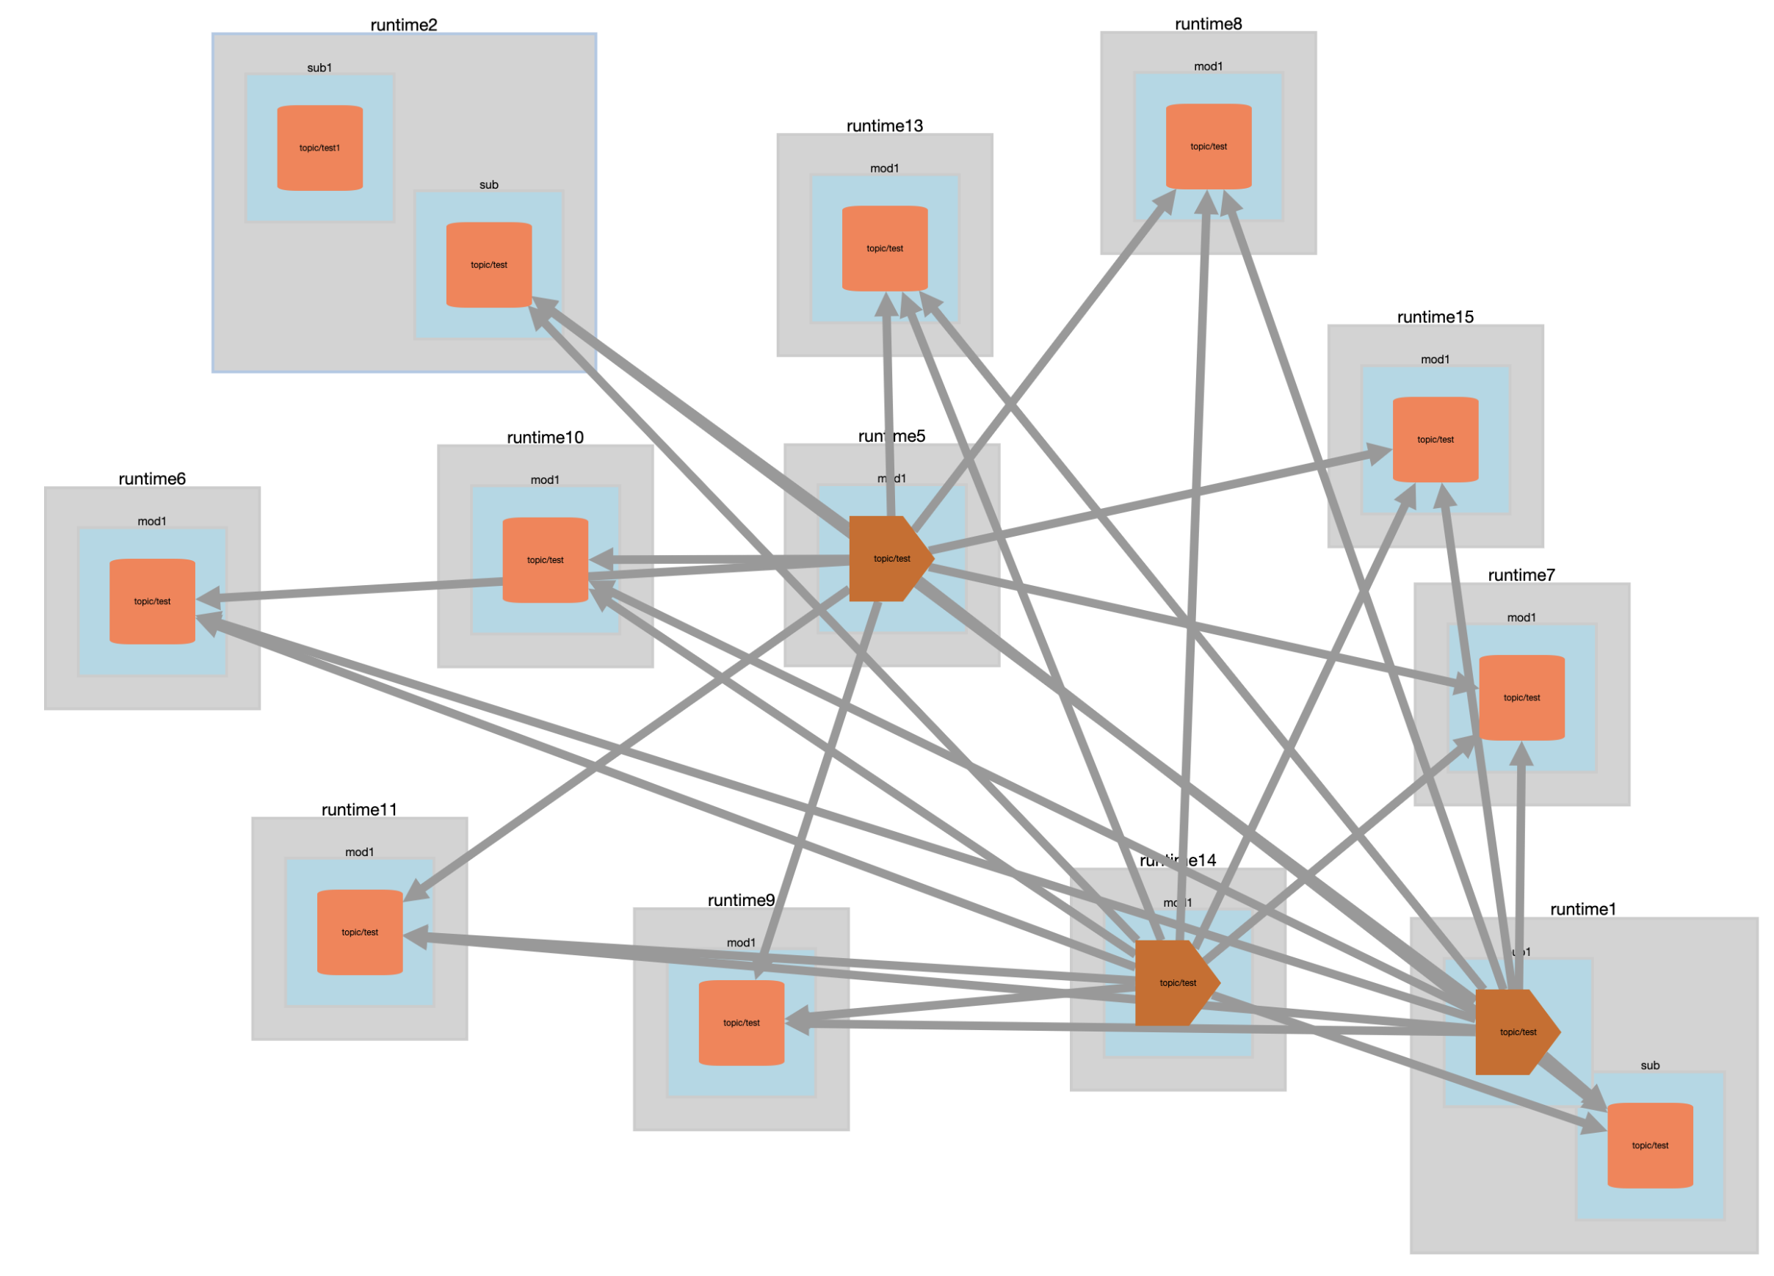








Headsets
Runtime Manager
Services
Sensors
Mobile
Run Time
PubSub
ARENA Realm

Slide 2
ARENA Architecture

Slide 3




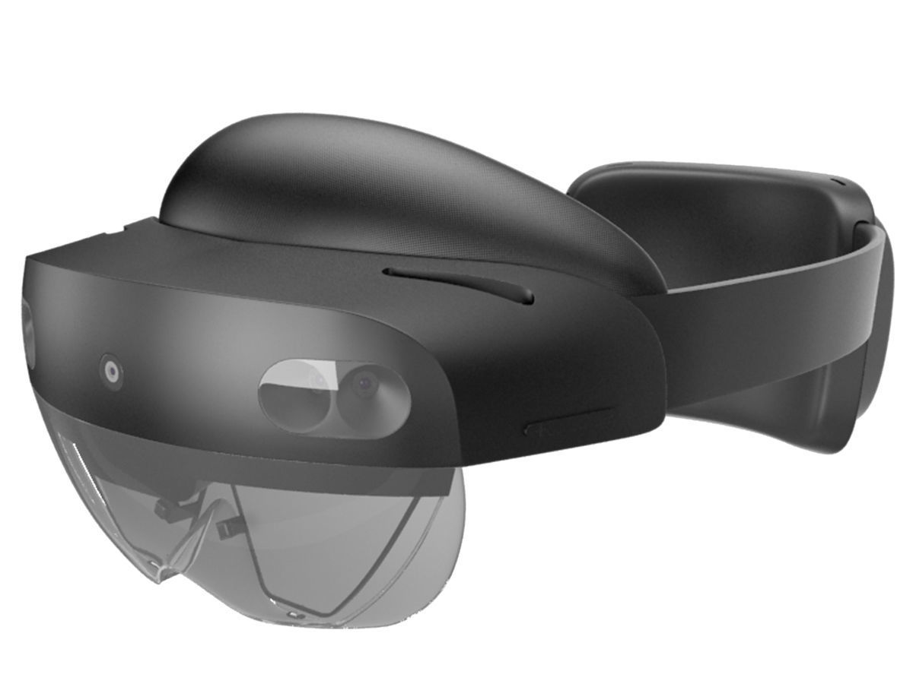


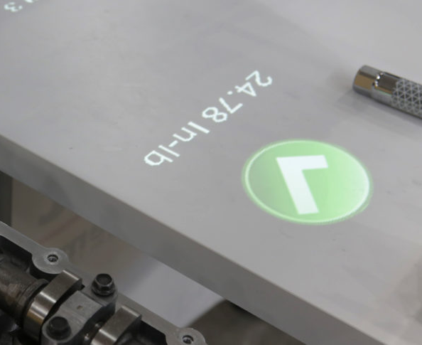
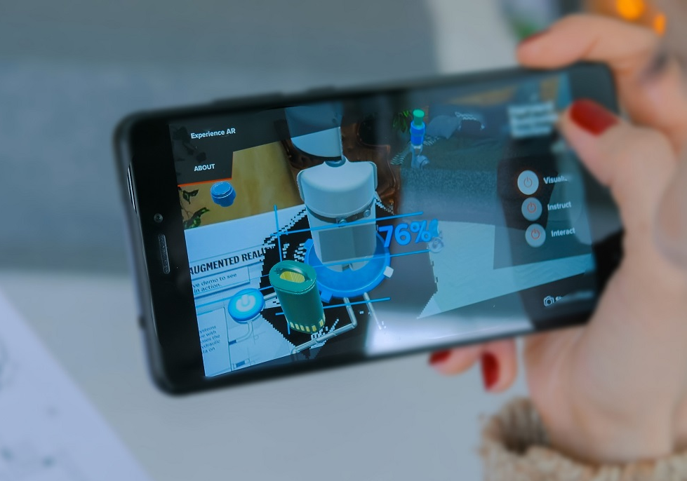


ARENA Client Stack
XR Browser Client
XR Browsers
Sandboxed
Applications
ARENA Runtime Manager
XR Platforms
ARENA Web Client
AR
VR
WebXR
A-Frame
three.js
WebGL
Projection AR
Mobile AR

Slide 4

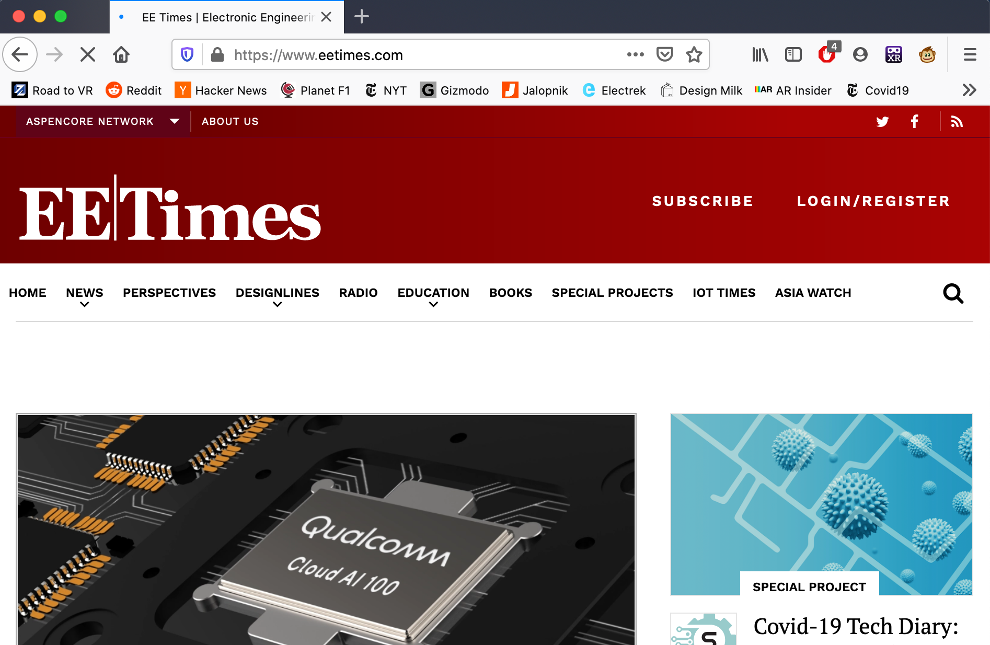

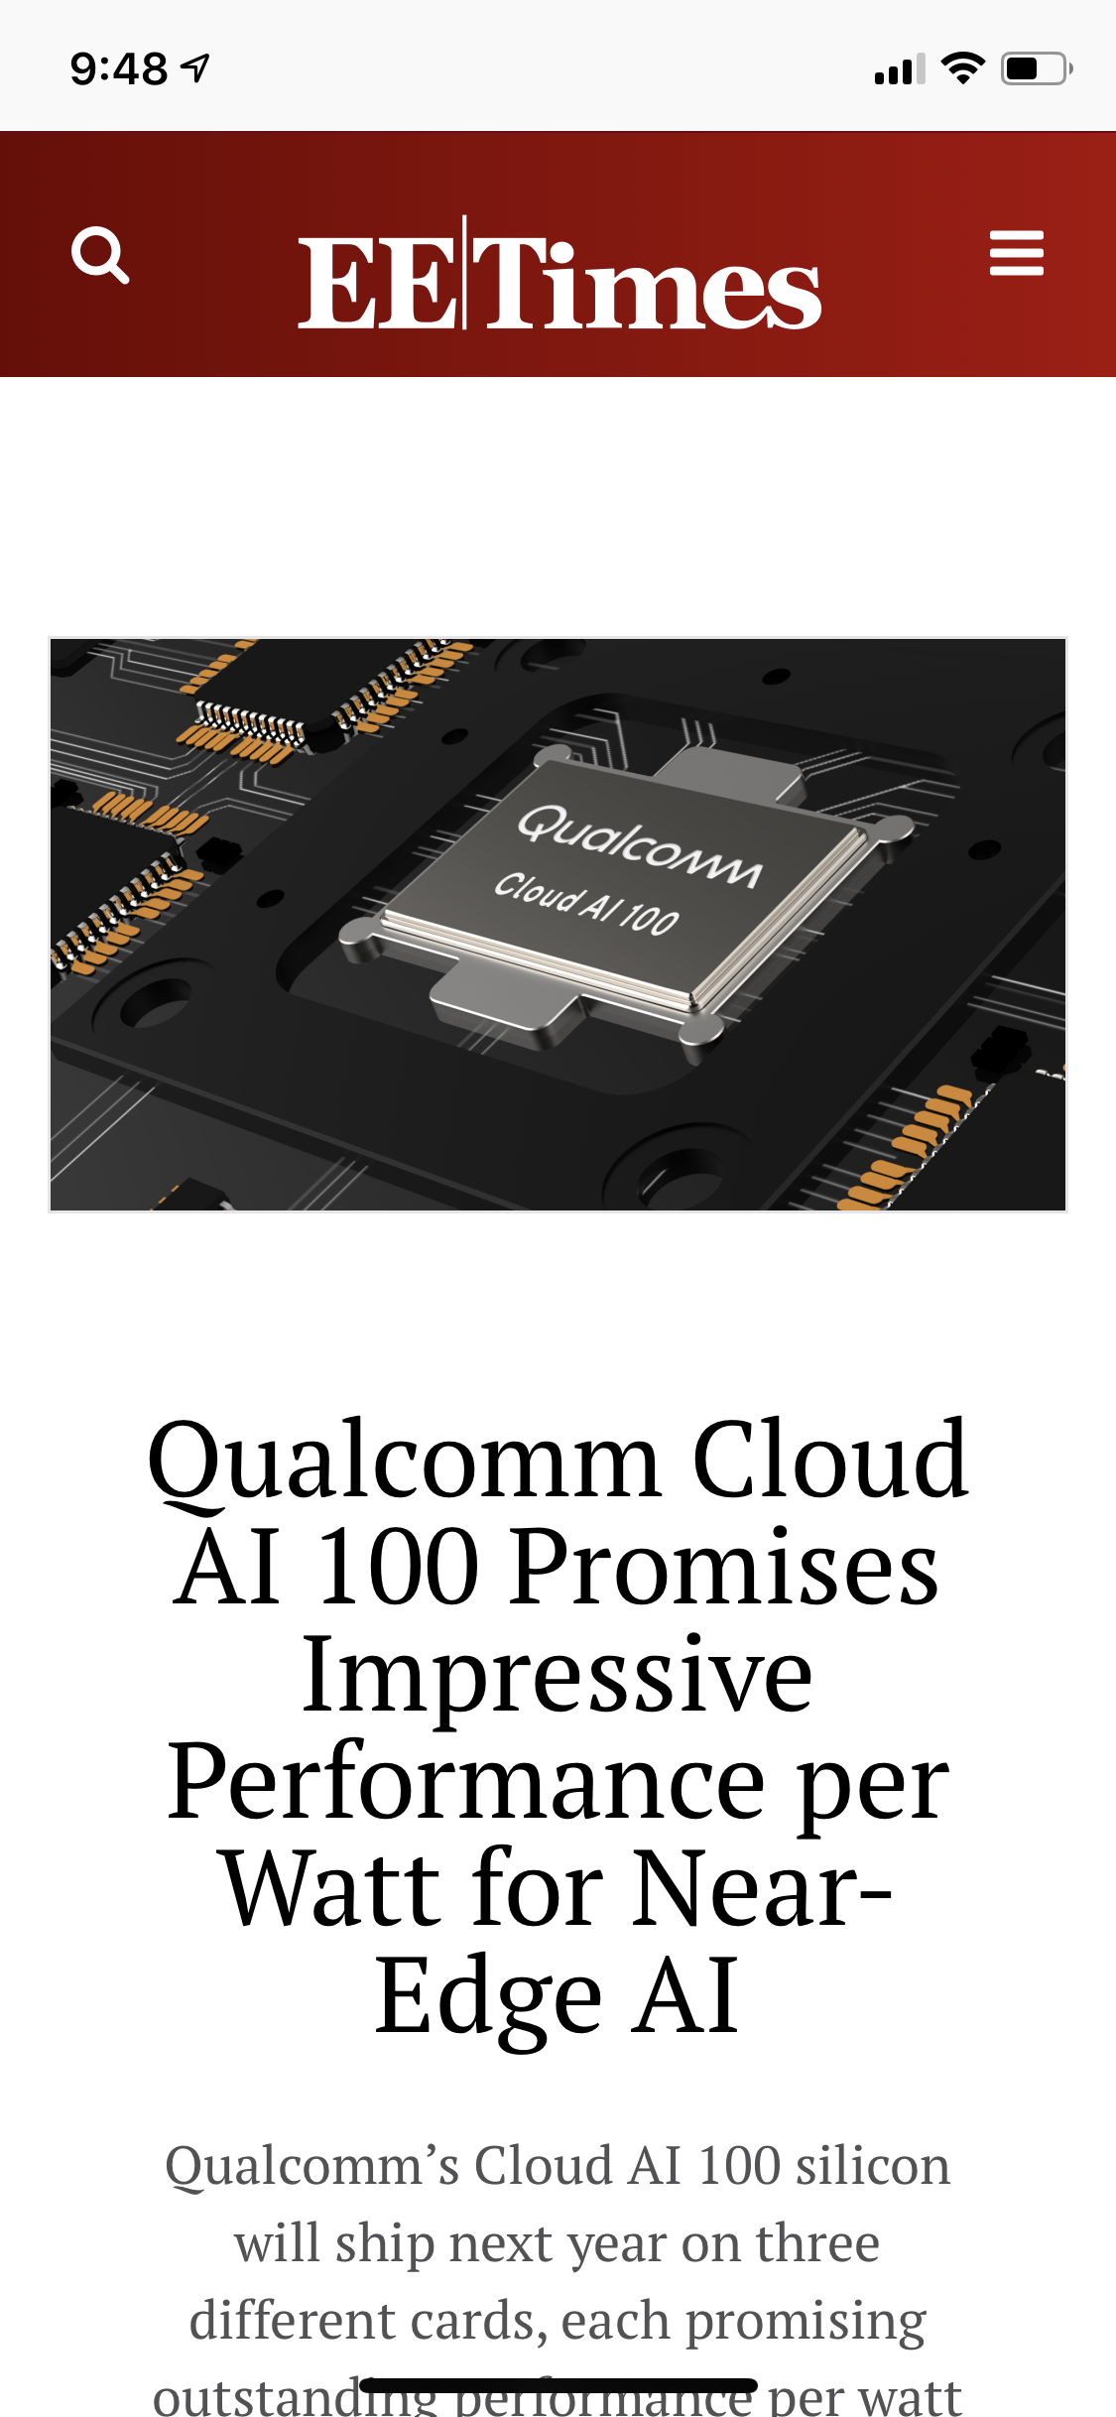



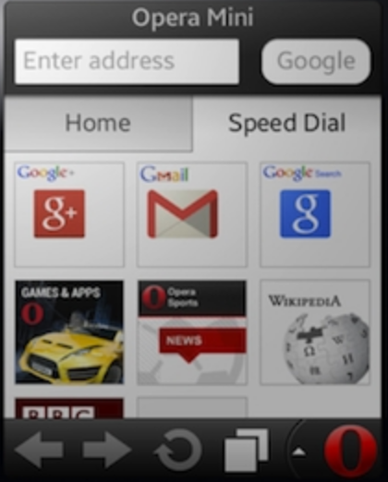
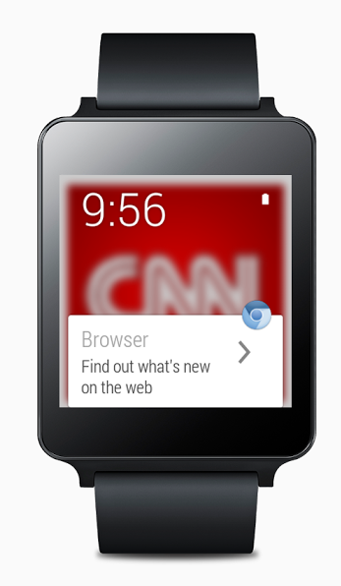

The Current “Web”
Content
Platform
Interpreter (Browser)
Page Rendering

Slide 5
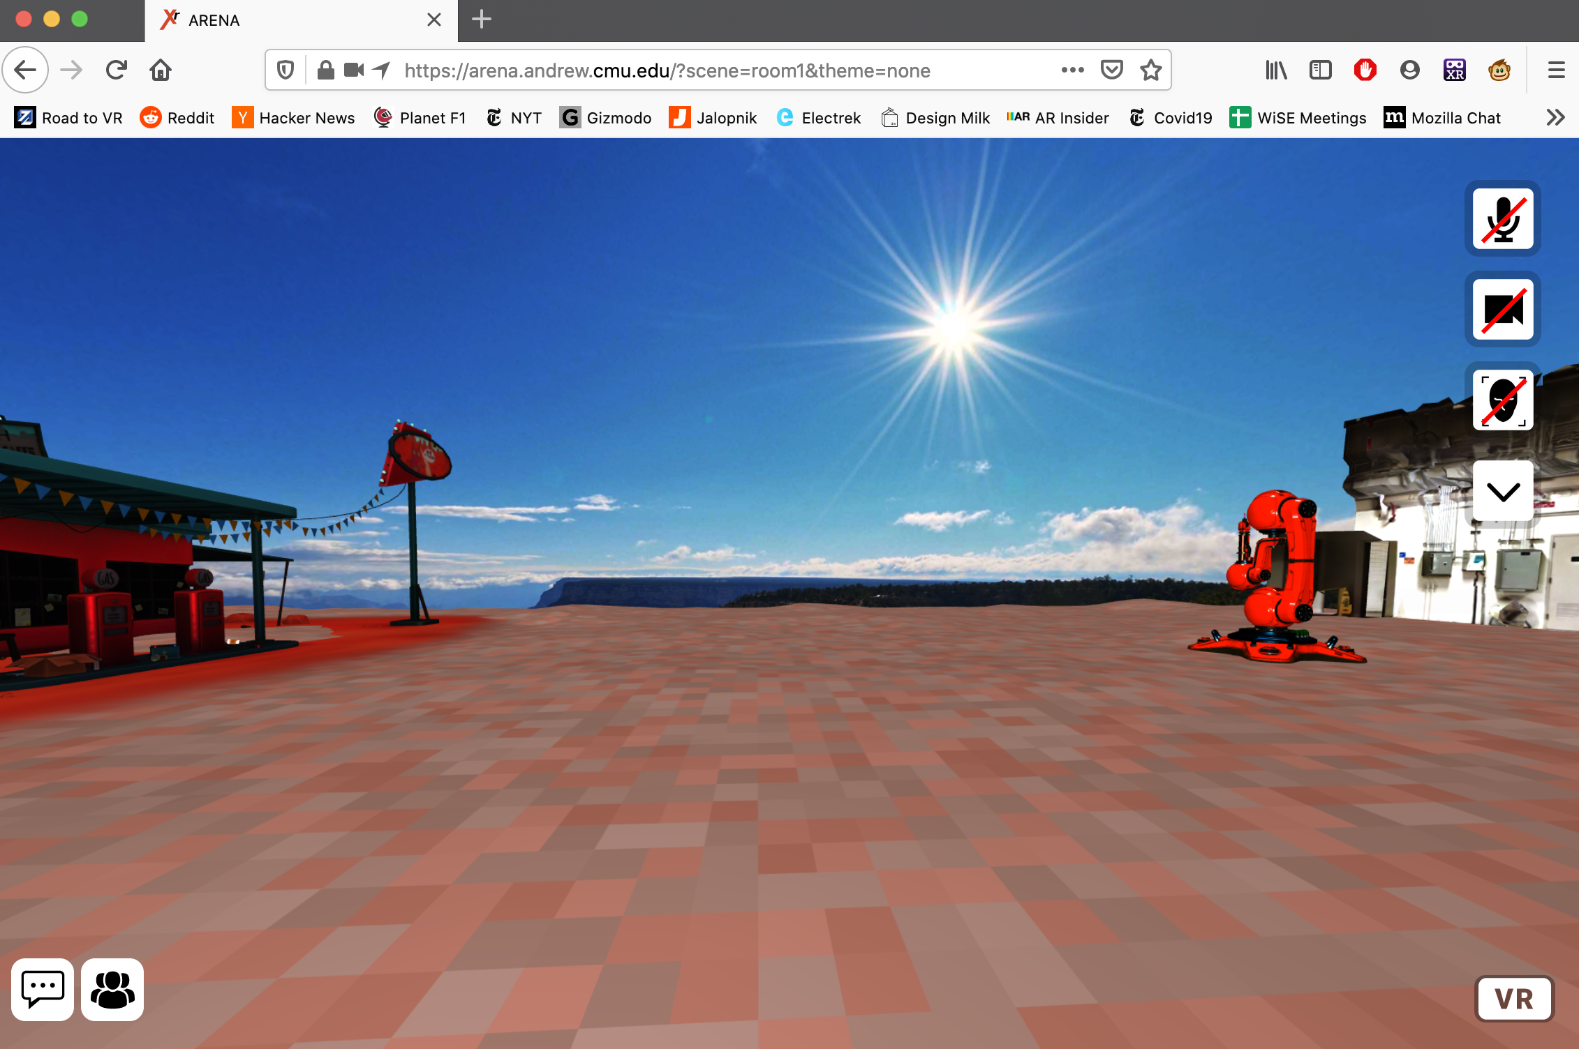
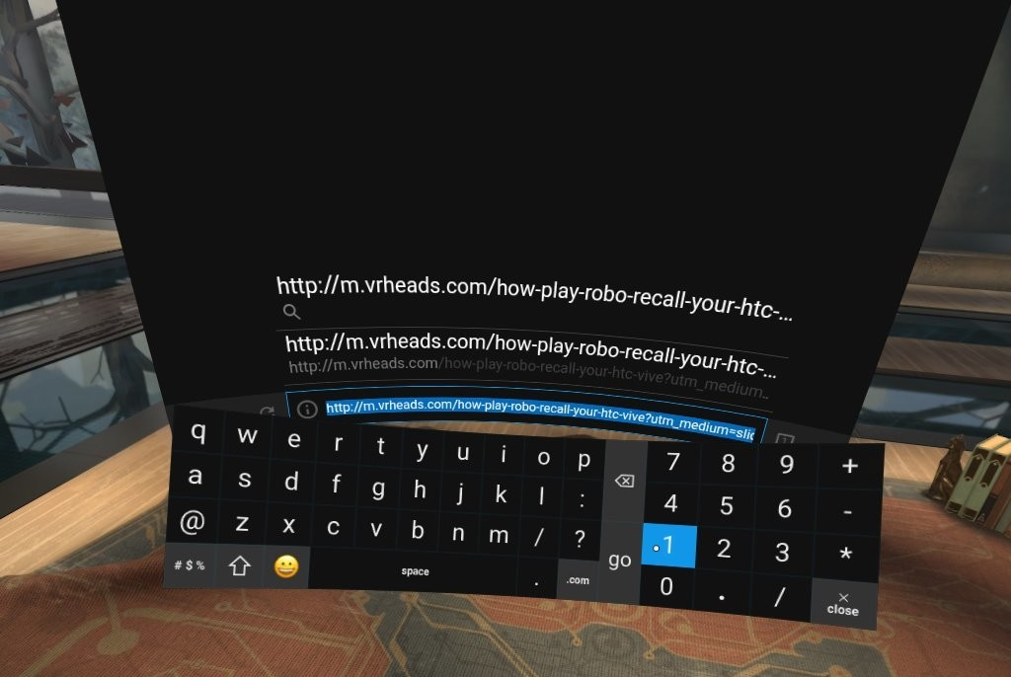

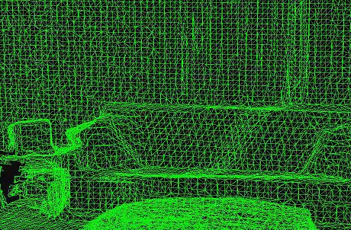
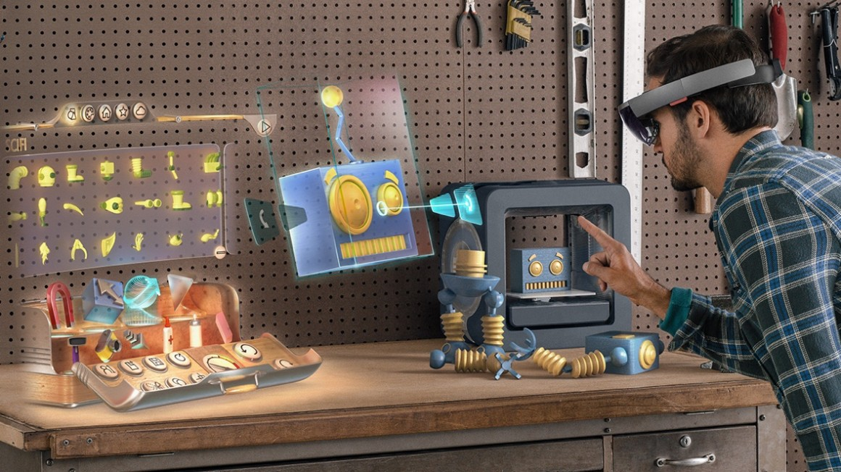
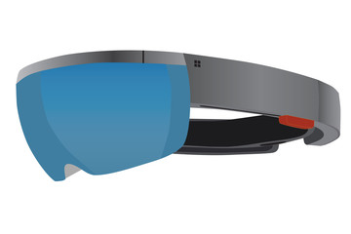

The “Spatial Web”
+
Content + World
Platform
Interpreter (Reality Browser)
Scene Rendering

Slide 6
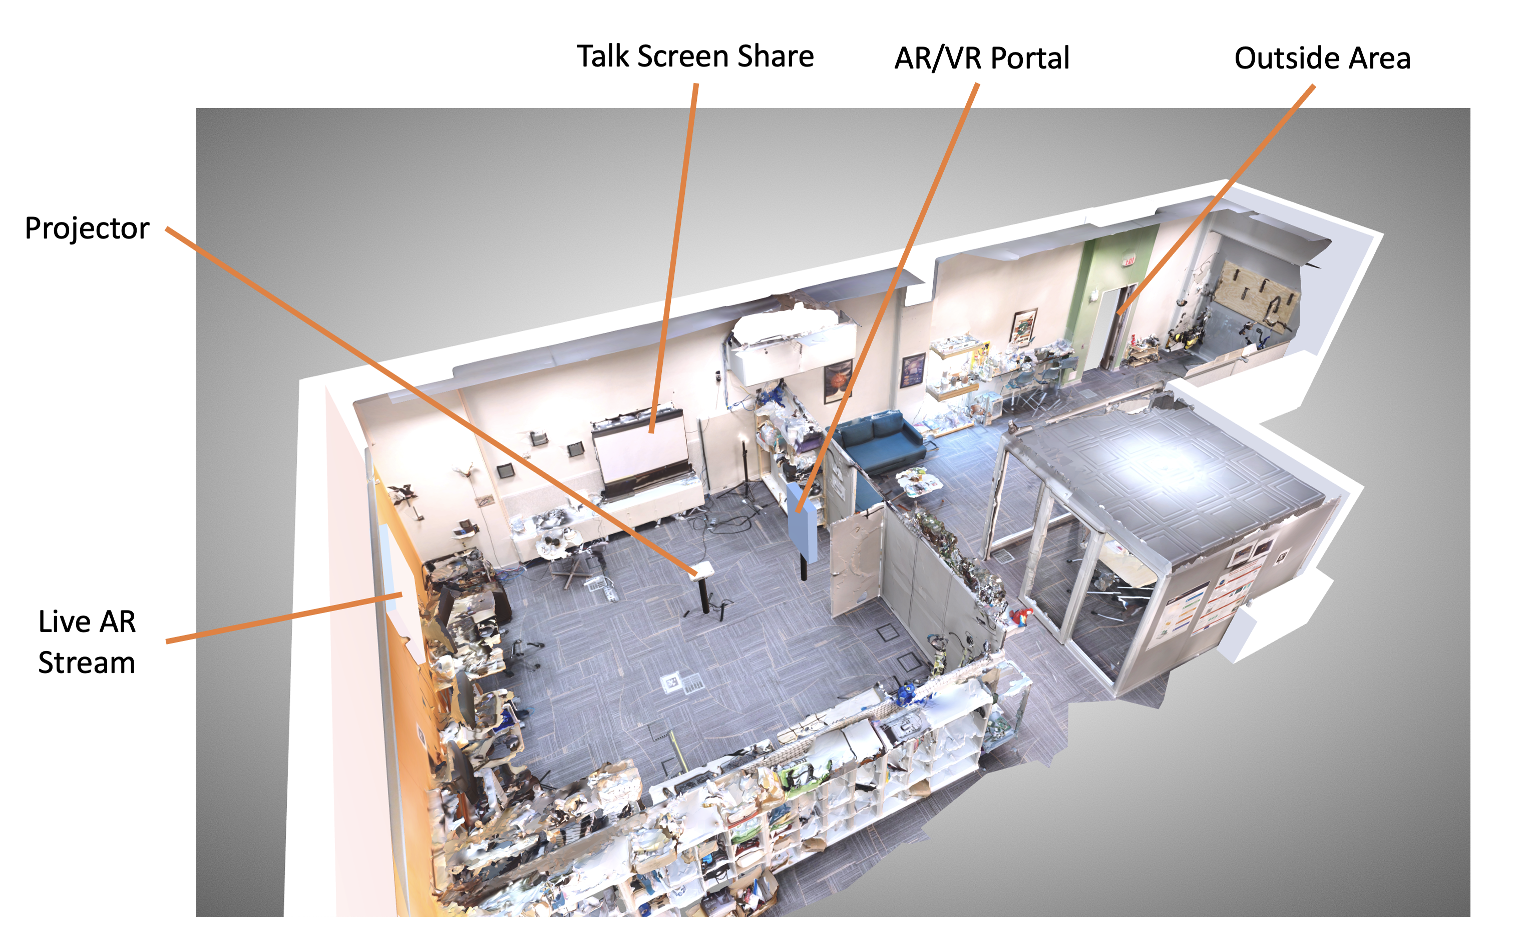
ISMAR 21 Hybrid Conference Competition Winner

